Slide 1

CSE-412 JAVA Theory
Group Name: C
Group Members
Nahian Raisa ID: 201014076
Farjahan Akter Boby ID: 201014007
Iqbal Hoshen Saif ID: 201014040

Slide 2
Problem Statement Demonstrate Bank Management Software using object-oriented programming concepts of the JAVA programming language

Slide 3
Objectives
To create two systems for employee and customer
Employee system will allow employees to operate operations such as add account, delete account and show account information
The account type can be current or savings as per customer choice
Customer system will allow customers to deposit money, transfer money or withdraw money
All this operations needs to be fulfilled using OOP concepts of JAVA

Slide 4
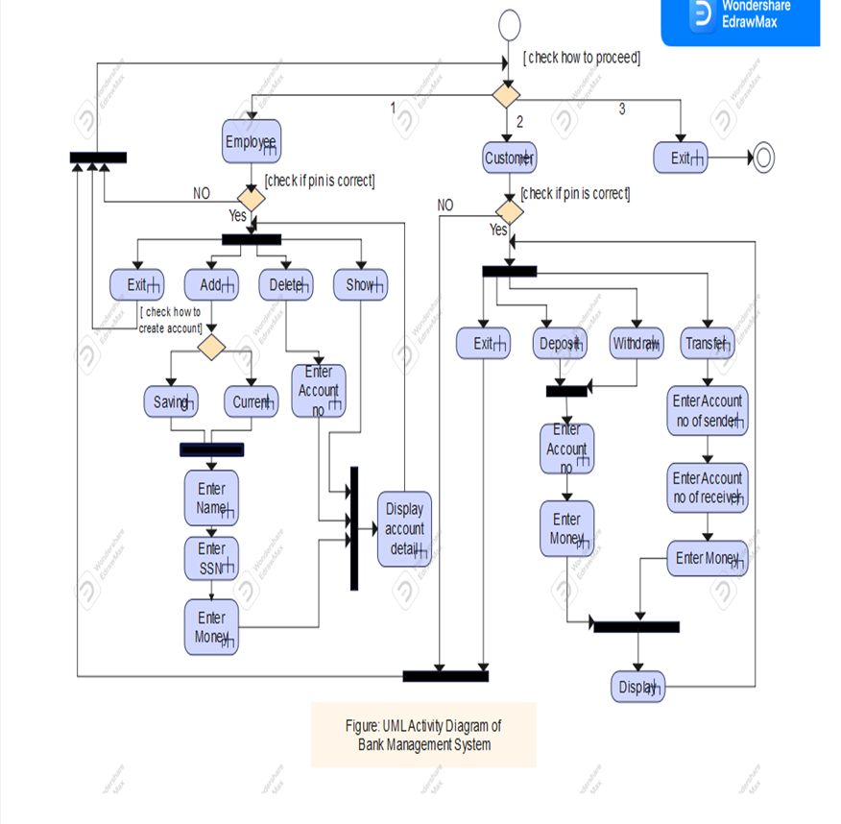
Design of our Software

Slide 5
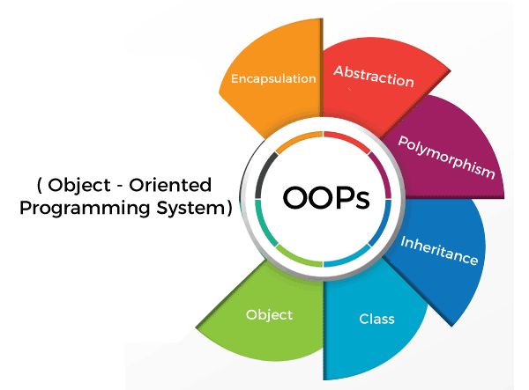
Object Oriented Concepts
Encapsulation
Inheritance
Polymorphism
Abstraction

Slide 6
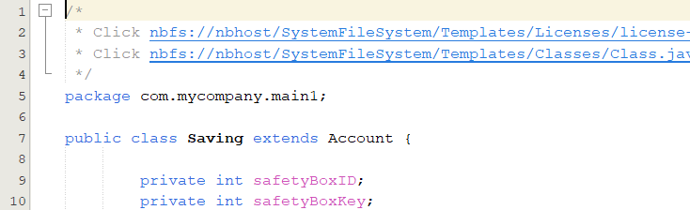
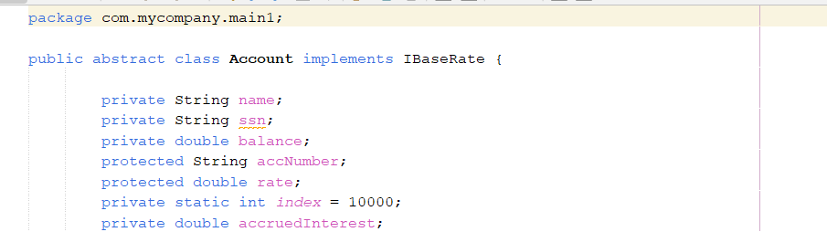
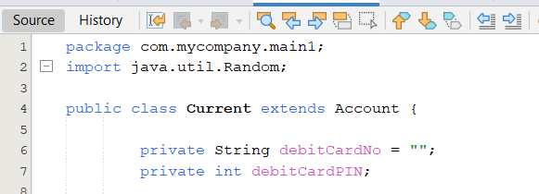
Encapsulation

Slide 7
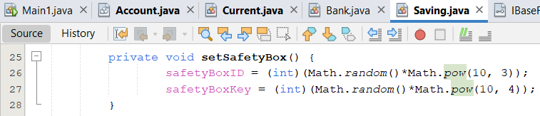
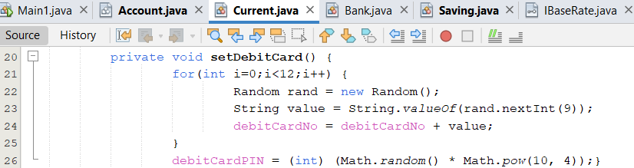
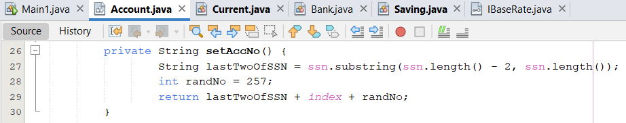
Encapsulation

Slide 8
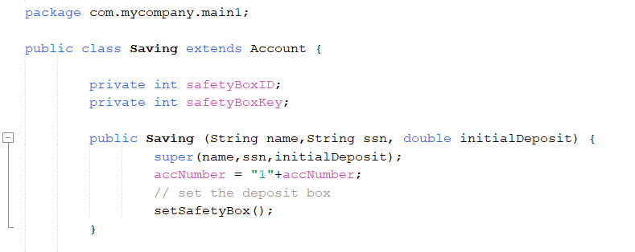
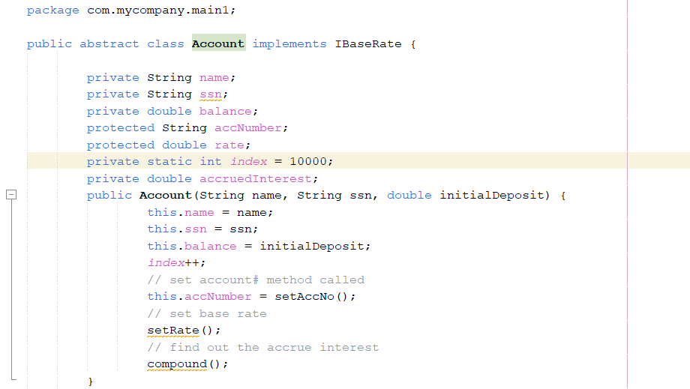
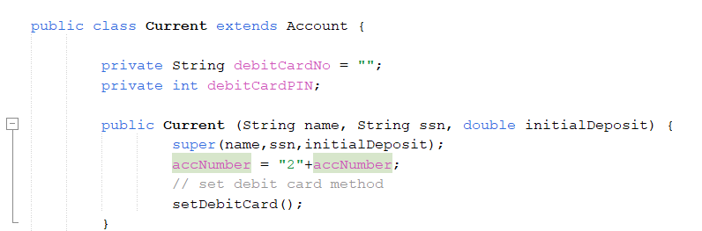
Inheritance
Parent Class
Child Class

Slide 9
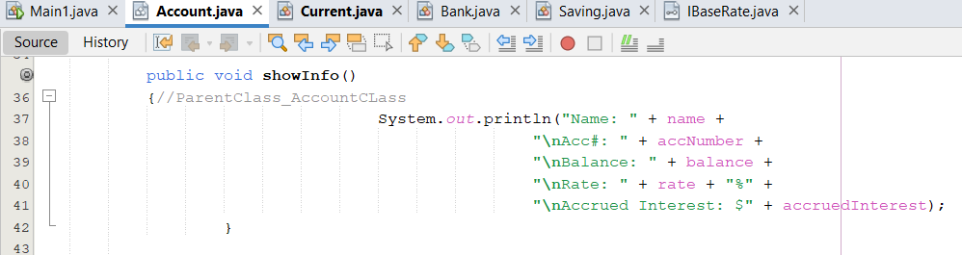
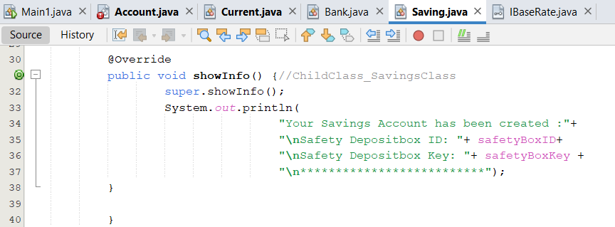
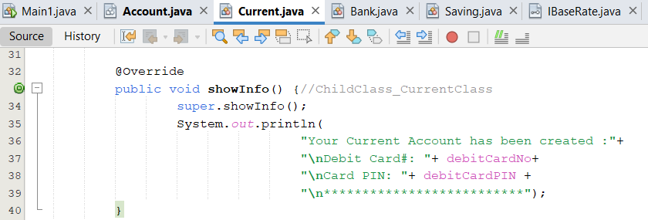
Polymorphism

Slide 10
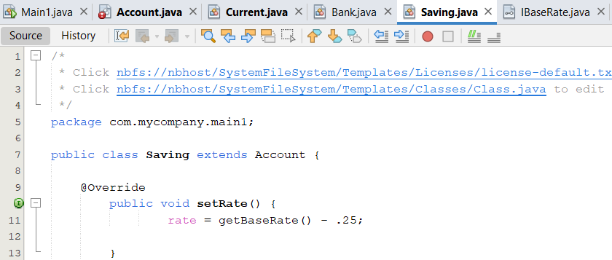
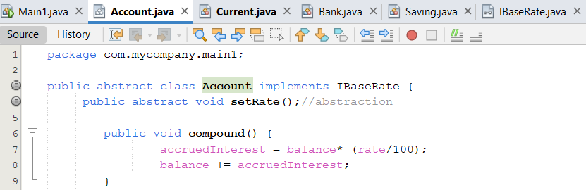
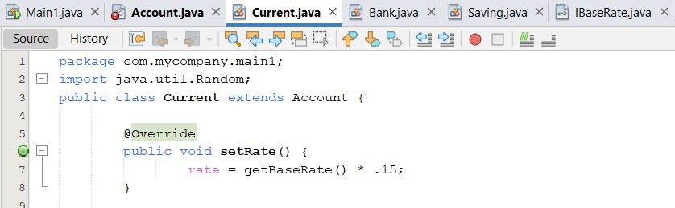
Abstraction
Abstract Class

Slide 11
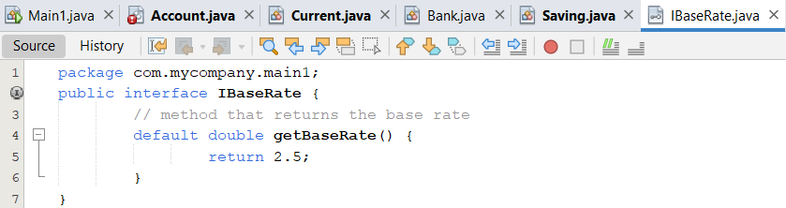
Interface
Interface Class

Slide 12
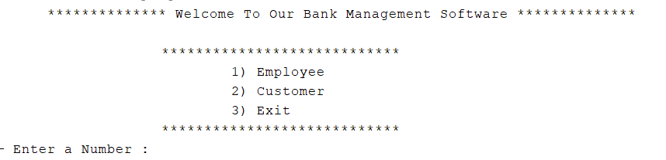
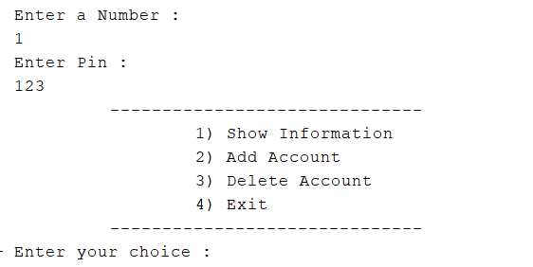
Code Output (Welcome Page)

Slide 13
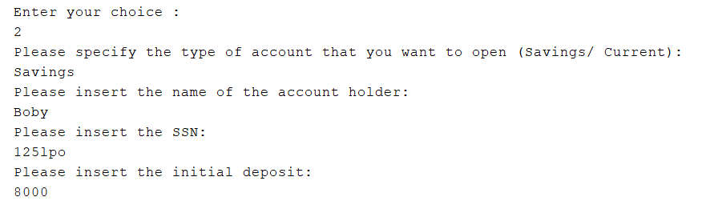
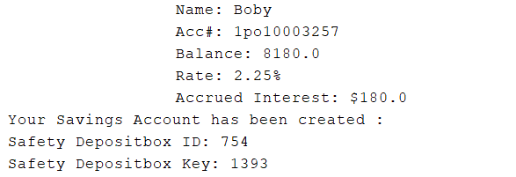
Code Output (Savings Account)

Slide 14
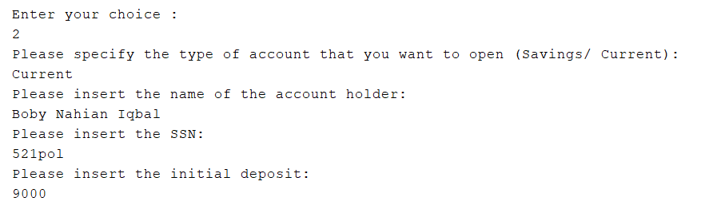
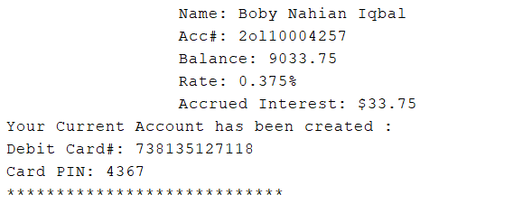
Code Output (Current Account)

Slide 15
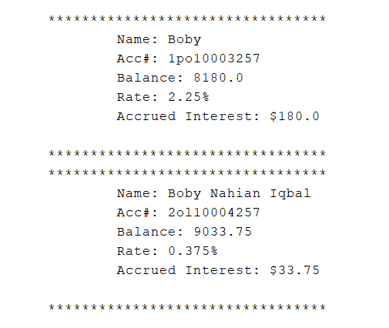
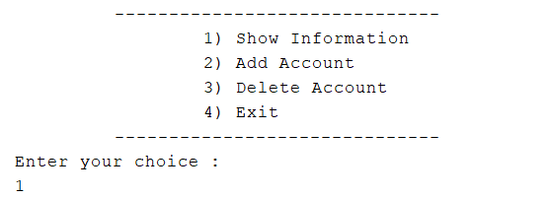
Code Output (Show Account Info)

Slide 16
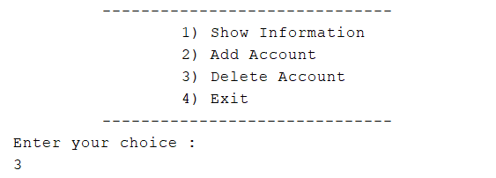

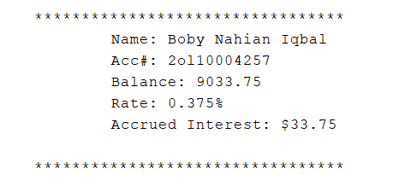
Code Output (Delete Account)

Slide 17
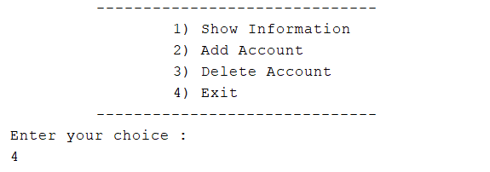
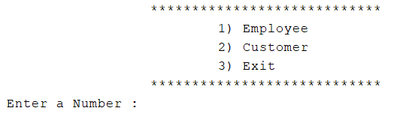
Code Output (Exit from Employee Interface)

Slide 18




Code Output (Deposit money)

Slide 19


Code Output (Withdraw money)

Slide 20

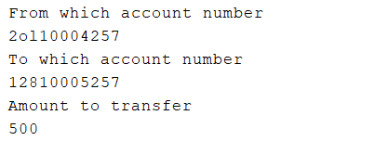

Code Output (Transfer Money)

Slide 21

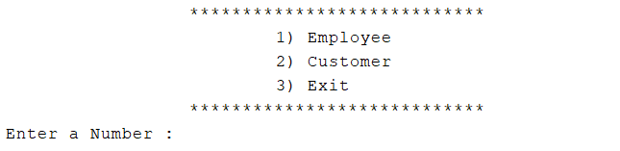
Code Output (Exit from Customer Interface)

Slide 22
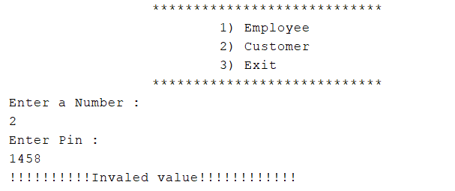
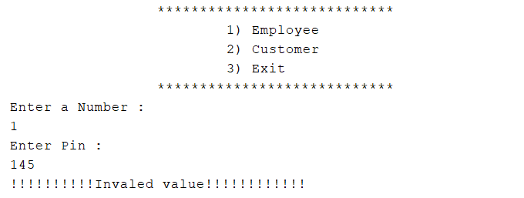
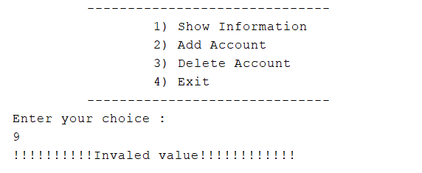
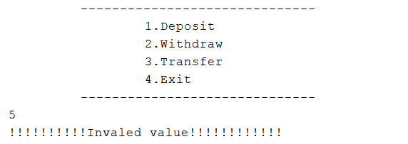
Code Output (User Input Error)

Slide 23


